Slide 1
Probability basics

Slide 2


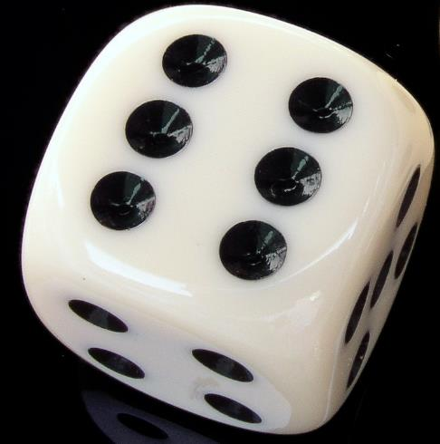



Experiments & sample space
An experiment refers to the process to obtain data
Sample Space: The collection of all probable outcomes of an experiment
The # of outcomes in a sample space can be finite or infinite, quantitative or qualitative (e.g., male vs female; or NBS vs SPMS students)
One single run of experiment leads to the realization of one outcome
$$S=\{1,2,3,4,5,6\}$$
$$S=[120cm,200cm]$$
$$S=\{0,1,2,3,4,5,6,…\}$$

Slide 3

$$S=\{1,2,3,4,5,6\}$$
2
MEANS
The outcome “{2}” has occurred

Slide 4



Events in a sample space
$$S=\{1,2,3,4,5,6\}$$
$$S=[120cm,200cm]$$
$$S=\{0,1,2,3,4,5,6,…\}$$
An event: a collection of one or more outcomes in a sample space
We can therefore define many events for an experiment
“Dice shows an even number”
“Height at least 160 cm”
“More than 2000 pax”

Slide 5

$$S=\{1,2,3,4,5,6\}$$
2
MEANS
The event “{2}” has occurred
The event “even number” has occurred
The event “{1,2,…,6}” has occurred
Event is a flexible notation to describe the outcomes of interests

Slide 6
Summary
Experiment produces one outcome stochastically
Sample space is the collection of all probable outcomes
We define event(s) to “bag” relevant outcomes according to the purpose of the research
Our objective, is thus to calculate the probability of the event of interest

